Slide 1

The meaning of percent
Percent means “per 100” or “out of 100.” The symbol for percent is %.
This pink lemonade cake is divided
into 100 equal pieces.
1%
If you eat one piece, you have eaten
1 out of 100 pieces or 1%.

Slide 2
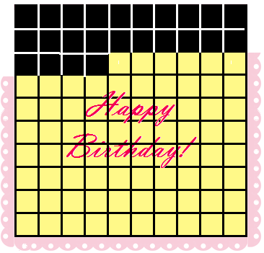
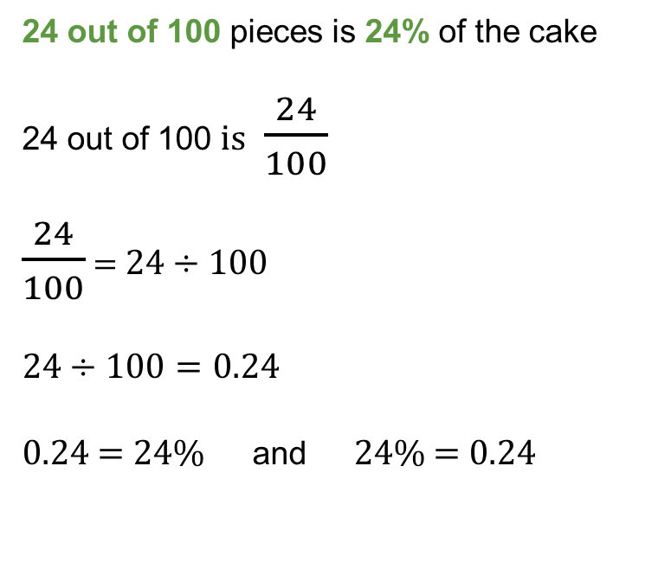
Calculating percentage
When you go back to the table for another piece, you see that 24 pieces have been eaten.
24 out of 100 pieces is 24% of the cake
24 out of 100 is $\frac{24}{100}$
$\frac{24}{100}$ = 24 $÷100$
24 $÷100=0.24$
0.24 = 24% and 24% = 0.24
The bar in a fraction means division.
24% or 0.24
Did you know?
0.24 is twenty-four one-hundredths. You can also say “zero point two four.”

Slide 3
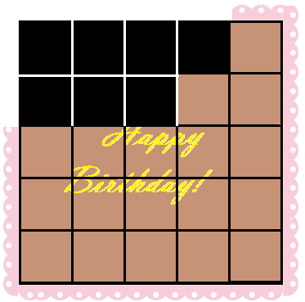
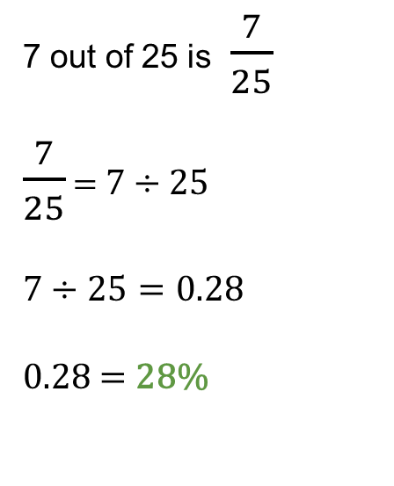
Any quantity can be written as a percentage!
If a fraction does not have a denominator of 100, it can still be written as a percentage by dividing.
This chocolate cotton candy cake is divided into 25 pieces and 7 of them have been eaten already.
7 out of 25 is $\frac{7}{25}$
$\frac{7}{25}$ = 7 $÷25$
7 $÷25=0.28$
0.28 = 28%
28%
28% of this cake has been eaten.

Slide 4
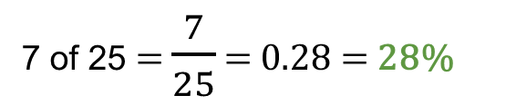
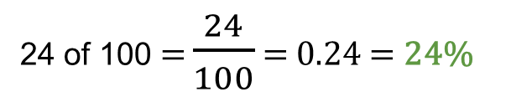
Comparisons using percentage
Have people eaten more of the pink lemonade cake or the chocolate cotton candy cake?
24 of 100 pieces have been eaten.
7 of 25 pieces have been eaten
More of this cake has been eaten!
24 of 100 = $\frac{24}{100}$ = 0.24 = 24%
7 of 25 = $\frac{7}{25}$ = 0.28 = 28%
28% is more than 24%!
People have eaten more of the chocolate cotton candy cake!

Slide 5
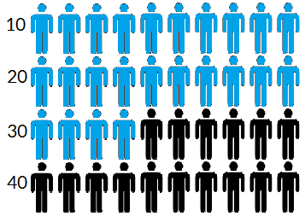
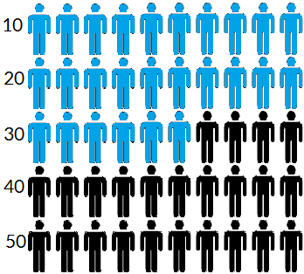
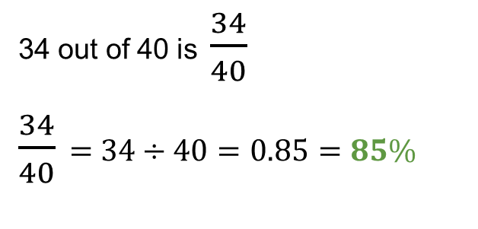
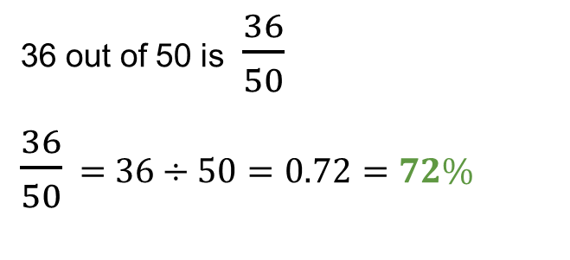
More comparisons using percentage
Which ice cream flavor was more popular in a taste test?
34 of 40 tasters loved
Banana Cream Pie
36 of 50 tasters loved
Mango Siracha
More Popular
34 out of 40 is $\frac{34}{40}$
$\frac{34}{40}$ = 34 $÷40=0.85=85\%$
36 out of 50 is $\frac{36}{50}$
$\frac{36}{50}$ = 36 $÷50=0.72=72\%$
85% of the tasters loved Banana Cream Pie.
72% of the tasters loved Mango Siracha.
Banana Cream Pie was more popular!

